Slide 1



FieldPro Stake

Slide 2
Client Machine Specs - Desktop
Processor
Intel® Core™ i3 Dual Core Processor 530 with VT (2.93GHz, 4M) or
Intel® Core™ i5 Dual Core Processor 660 with VT (3.33GHz, 4M) *
Operating System (OS)
Genuine Windows® 7 Pro 64bit with SP1 or Windows® 8.1 Pro 64bit or Windows 10 Pro 64bit

Slide 3
Client Machine Specs – Desktop – Cont’d
Memory (RAM)
8.0GB DDR3 Non-ECC SDRAM, 1333MHz, (4DIMM)
Hard Drive
160GB 10,000 RPM 3.5" SATA, 3.0Gb/s Hard Drive with 16MB Cache

Slide 4
Client Machine Specs – Laptop
Processor
Intel® Core™ i5-540M (2.53GHz, 3M cache) with Turbo Boost Technology
Operating System (OS)
Genuine Windows® 7 Pro 64bit with SP1 or Windows® 8.1 Pro 64bit or Windows 10 Pro 64bit

Slide 5
Client Machine Specs – Laptop
Memory (RAM)
8.0GB, DDR3-1066MHz SDRAM, 2 DIMMS
Hard Drive
250GB 7200rpm Hard Drive
Graphics
512MB NVIDIA® NVS 3100M

Slide 6
iPad Specs
9.7 or 10.5 inch iPad Pro Wi-Fi + cellular (for best experience)
Apple Pencil (not required but recommended)
iOS 9.0 or higher
FieldPro is not compatible with iOS < 9.0 and iPads manufactured before March 7, 2012

Slide 7
GPS and iPad/FieldPro
Wi-Fi only iPad’s do not include a GPS receiver. GPS is included in the Wi-Fi + Cellular model iPads only.
An external GPS can be used with a Wi-Fi only or Wi-Fi + Cellular iPad
Trimble Pro Series: R2 GNSS, R1 GNSS
EOS Arrow Series: Gold, 200, 100, Arrow Lite
Bad Elf: GNSS Surveyor, GPS Pro+, GPS Pro

Slide 8
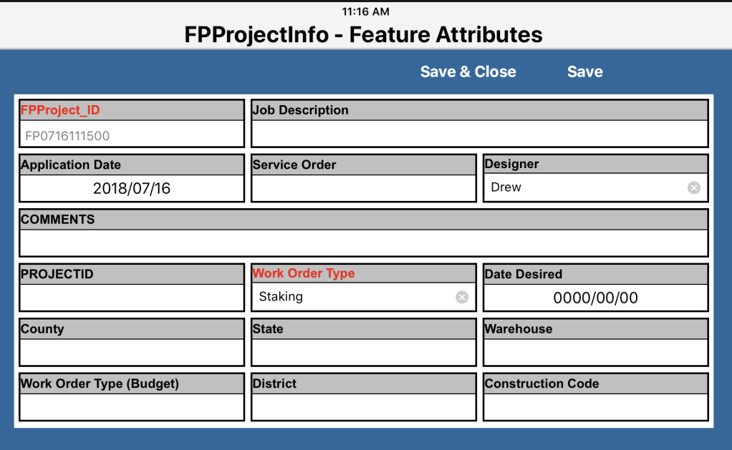
Staking A New Service
Create a new FPStake project
Populate Work Order Type
Populate Job Description

Slide 9
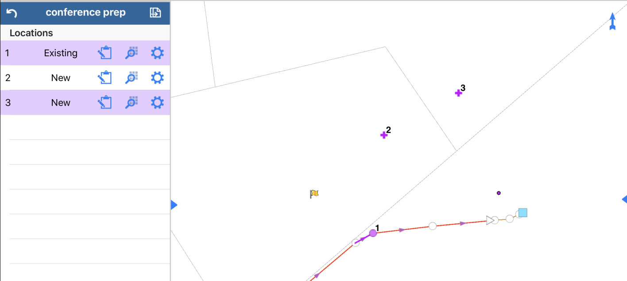
Staking A New Service
Add Existing/New Locations
Locations can be added manually by tapping the screen or
By clicking the “Stamp” button on the GPS toolbar to create a location based off of a GPS receiver.

Slide 10
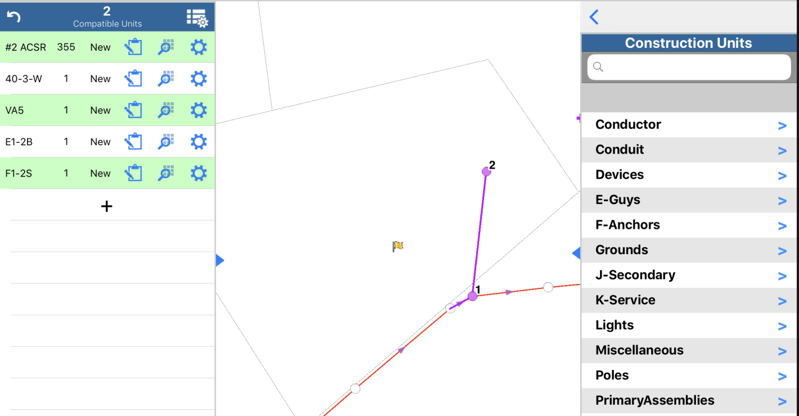
Staking A New Service
Correct any invalid units
Add missing units
Add new units

Slide 11
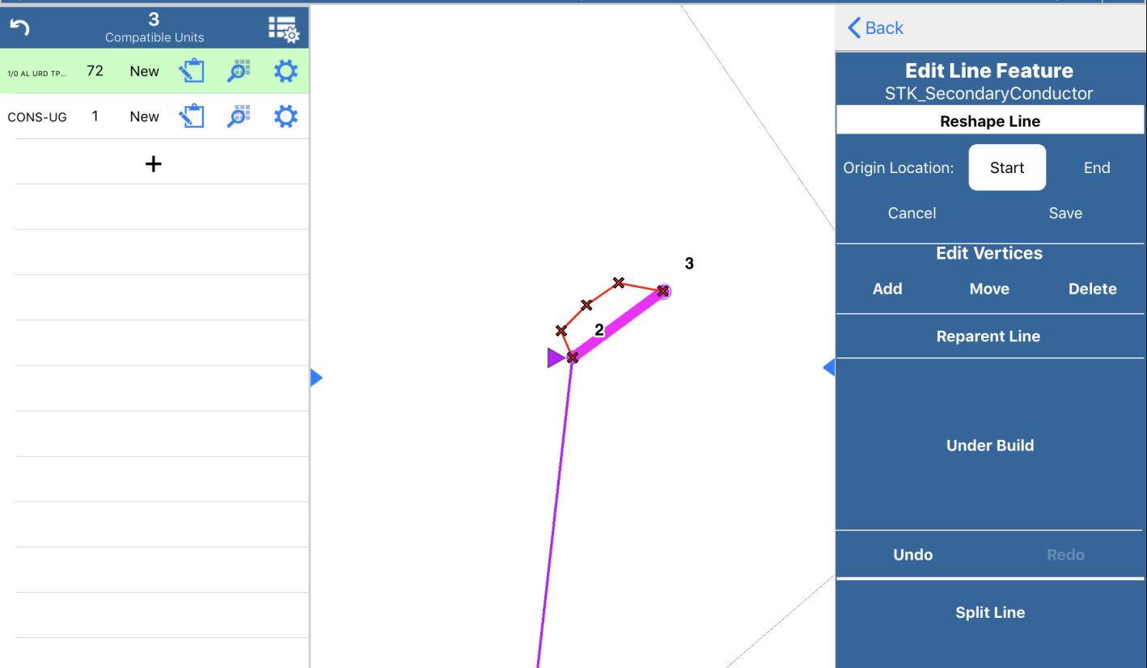
Staking A New Service
Re-shape any underground lines
Move vertices
Add vertices
Split lines

Slide 12
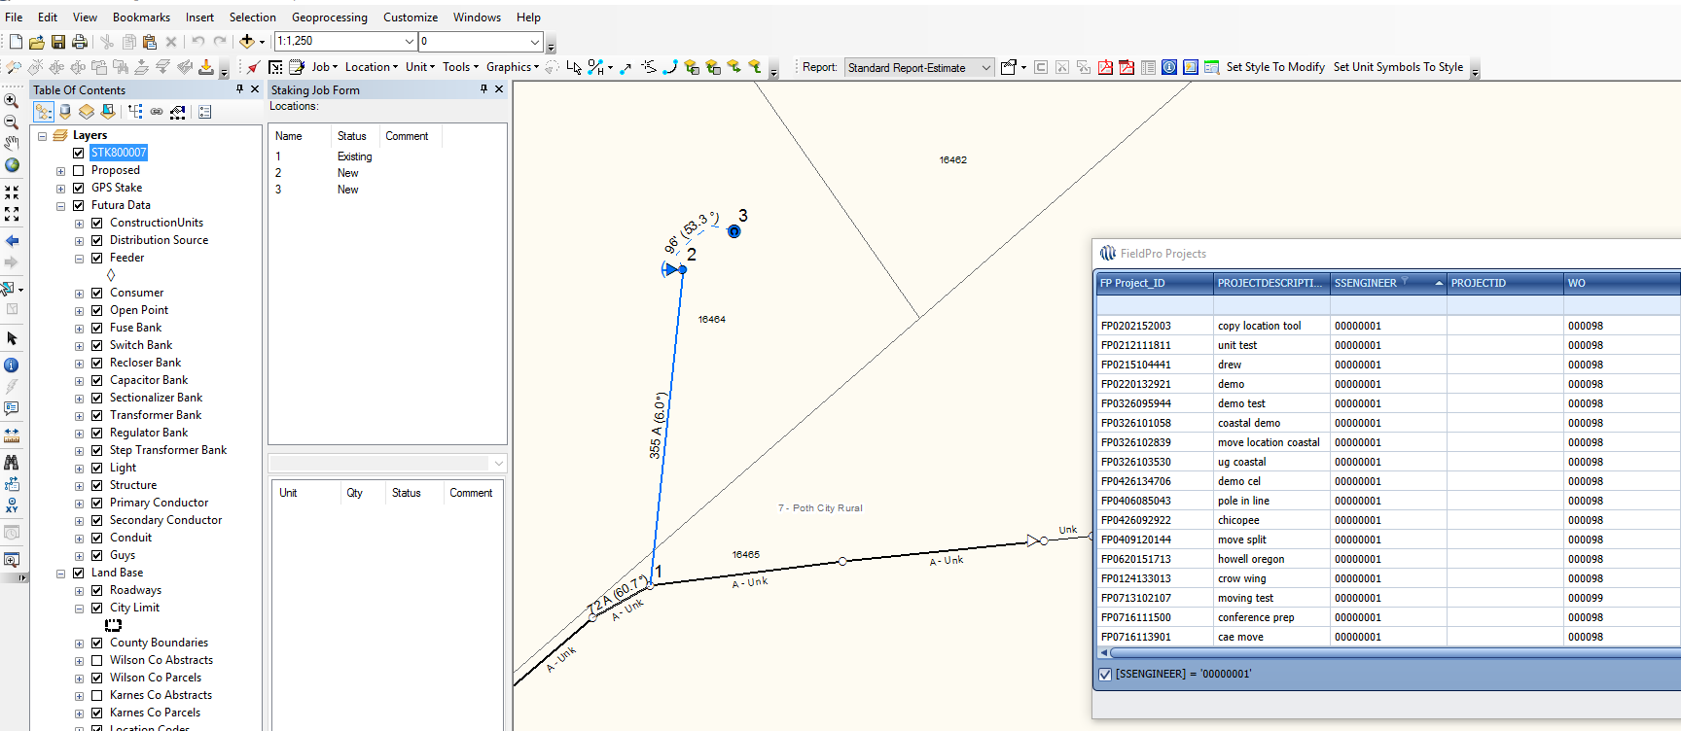
Staking A New Service
Upload the job in FieldPro Stake
Open Import tool from windows staking
Once the job is imported you can continue complete design and job information

Slide 13
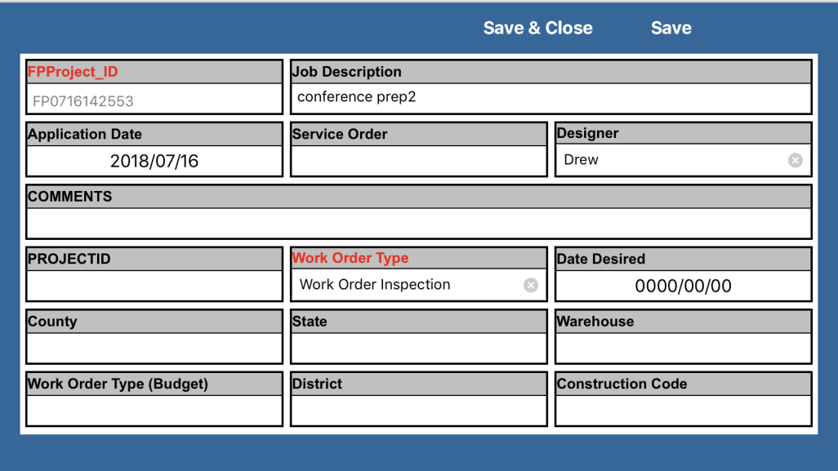
Correcting Existing Data
Create a new FPStake project
Populate Work Order Type
Populate Job Description

Slide 14
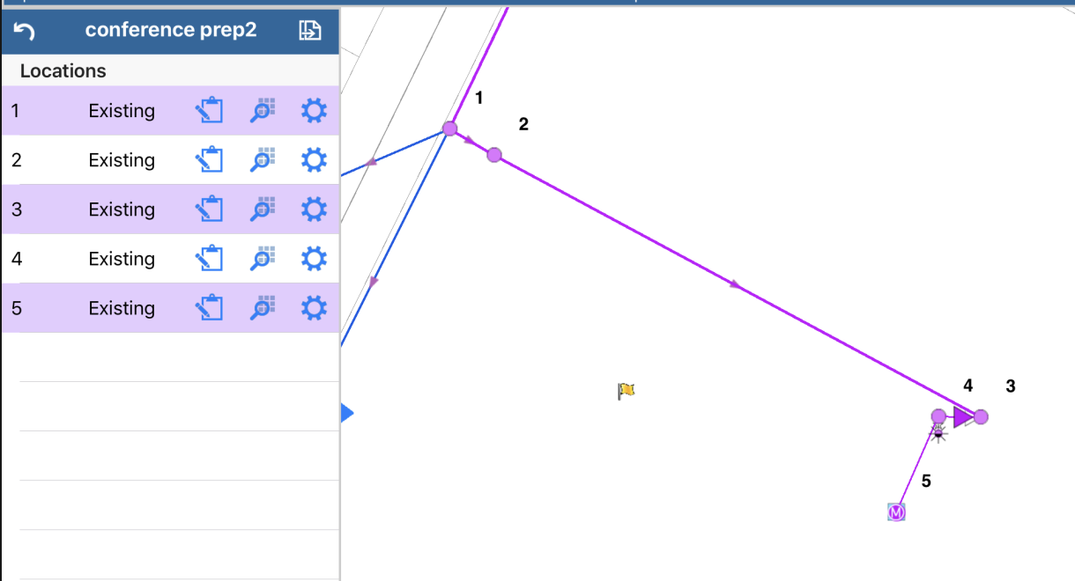
Correcting Existing Data
Select Existing locations to be moved
Add missing units
Correct invalid units

Slide 15


Correcting Existing Data
Select the gear symbol for the location that will be moved
Select the move feature tool

Slide 16
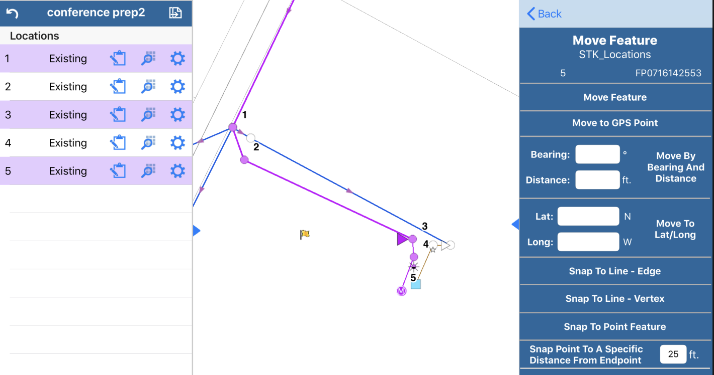
Correcting Existing Data
If you are using GPS select the “Move to GPS Point” button or
Select “Move Feature” button to manually move the feature

Slide 17
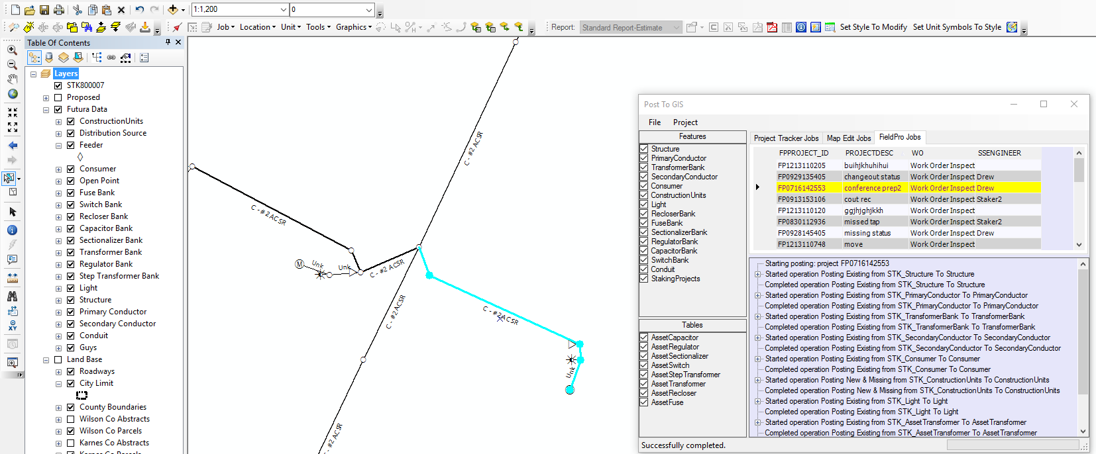
Correcting Existing Data
Upload job
Open “Post to GIS” tool in Mapping
Post job from the FieldPro Jobs tab

Slide 18
Correcting Existing Data
Upload job
Open “Post to GIS” tool in Mapping
Post job from the FieldPro Jobs tab

Slide 19

Coming Attractions
Phase 2 of development

